Slide 1

By Meinrad Recheis

Slide 2

If this is Machine Learning in Python ...

Slide 3

... then this is Machine Learning in C#

Slide 4

Our mission is to to change that.
SciSharp is an Open Source Organization
An international team of skilled C# developers with ML background
The goal: make major ML frameworks available to .NET community

Slide 5
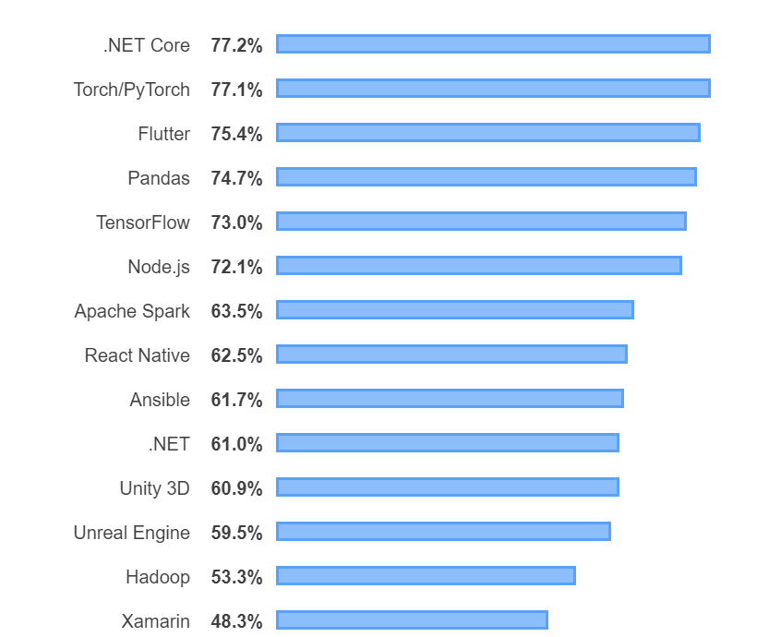
Stack Overflow Developer Survey
„Most Loved Other Frameworks, Libraries and Tools“
Makes sense to bring loved developer tools closer together

Slide 6


Slide 7
A C# port of TF with bindings to the highly efficient C++ CPU/GPU computation layers
Status of TensorFlow.NET
Inference [stable, ready to use]
Training [beta, works for many models]
Building models from scratch in C# [alpha, works for some models]
106,327 lines of code
3,412 downloads on Nuget as of June 2019

Slide 8
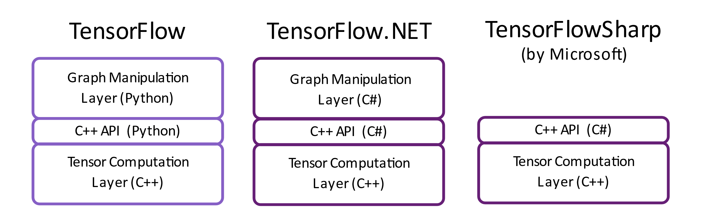
Architecture and Comparison

Slide 9
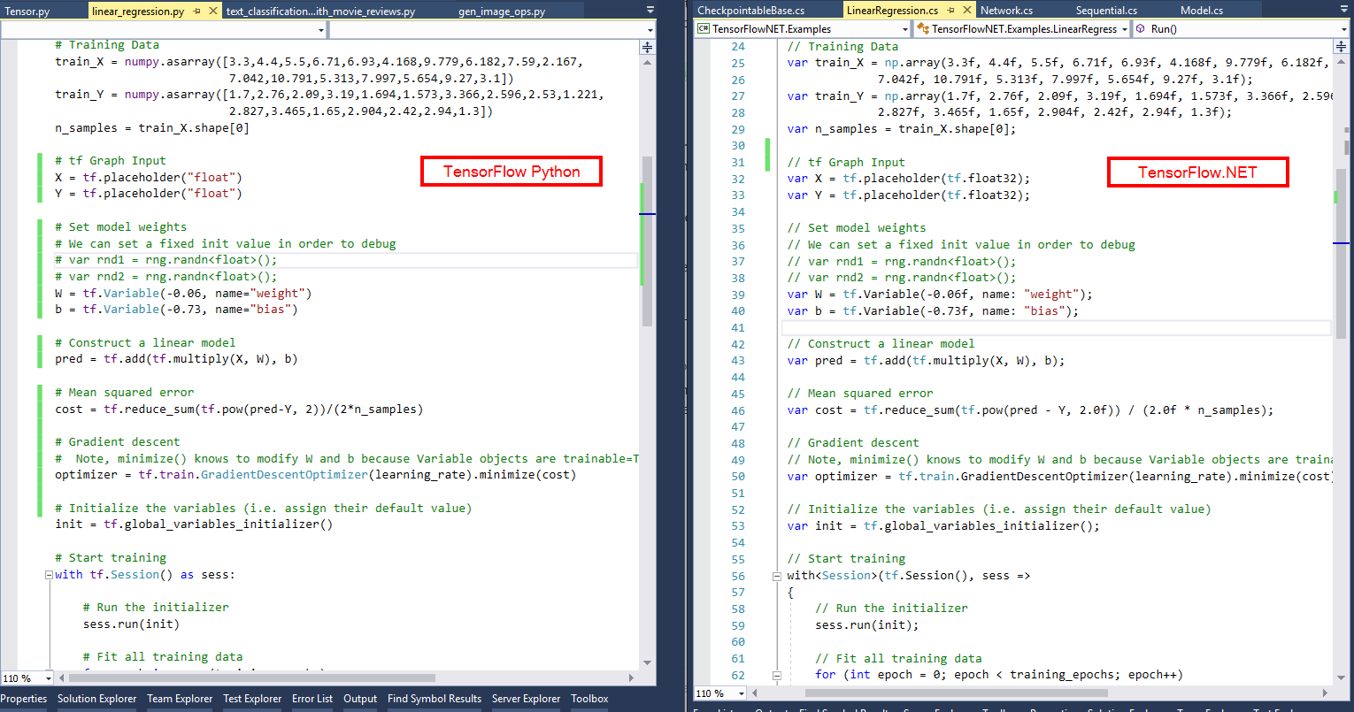

Slide 10


Slide 11
A pure C# implementation of NumPy‘s API with interchangable numerical computation engines
Status of NumSharp [stable, but somewhat incomplete]
Used by TensorFlow.NET (i.e. for batching)
Implements a large subset of the NDArray API
23,117 lines of code
6,992 downloads on Nuget as of June 2019

Slide 12
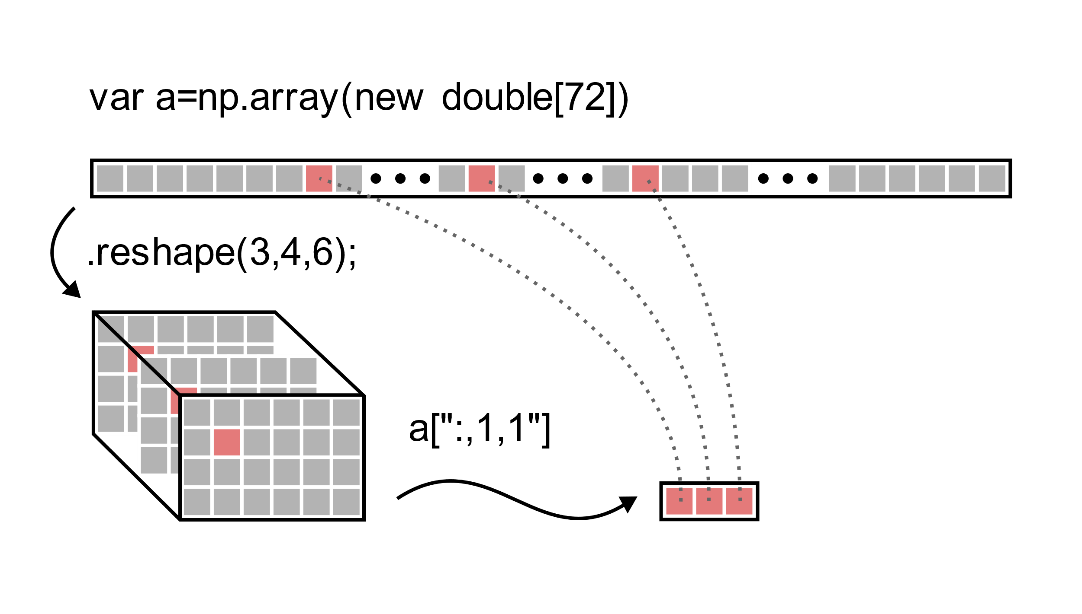

Slide 13
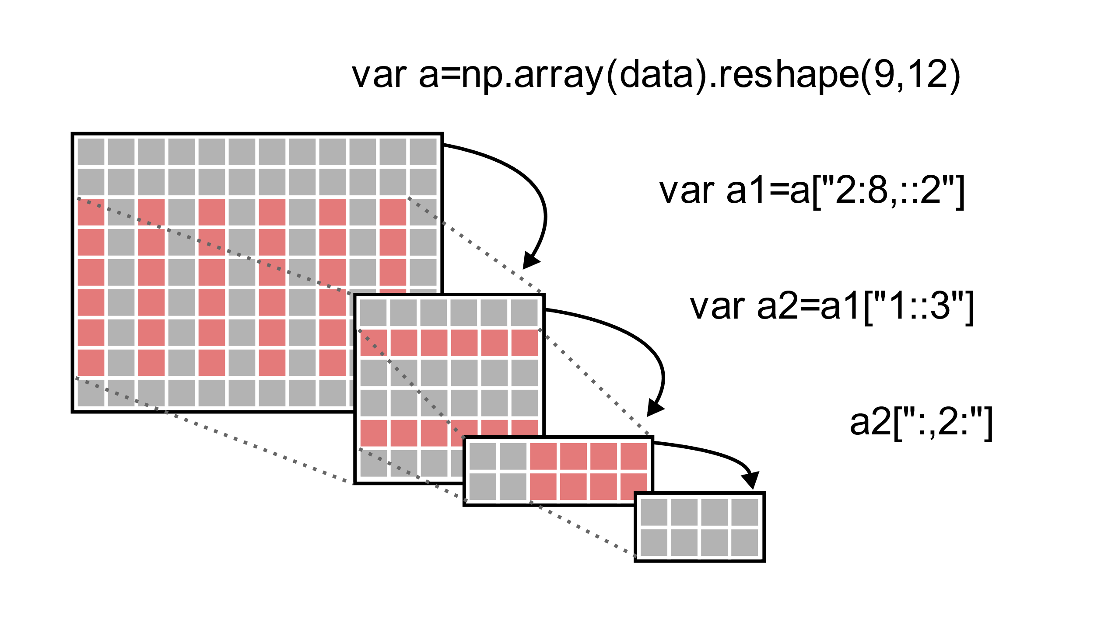

Slide 14


Slide 15
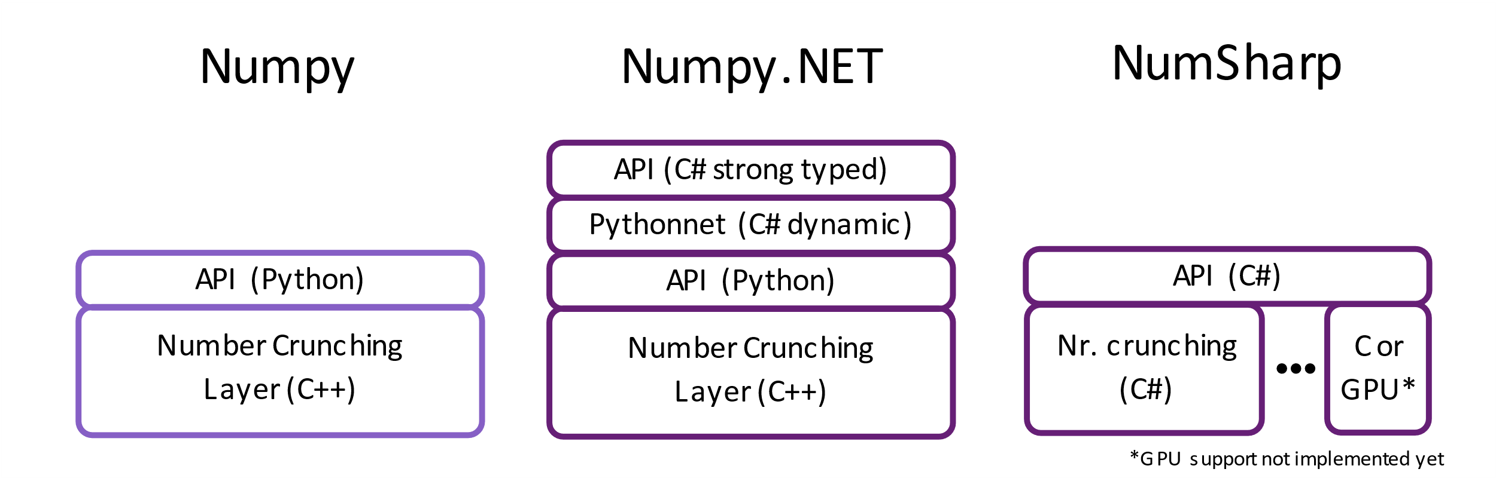
Architecture and Comparison

Slide 16
The most complete .NET bindings for NumPy.
Status of Numpy.NET [stable, ready to use]
Used by Keras.NET and Torch.NET
Auto-generated: implements the complete NDarray API
> 500 API functions
144,016 lines of code
Available as a standalone Nuget as well as one that depends on Python

Slide 17


Slide 18
.NET bindings for the high-level NN API running on top of TensorFlow, CNTK, or Theano.
Status of Keras.NET [stable, ready to use]
Mostly auto-generated: implements ~90% of the Keras API
7,573 lines of code
Several working examples published

Slide 19
// Build CNN model
var model = new Sequential();
model.Add(new Conv2D(32, kernel_size: (3, 3).ToTuple(), activation: "relu", input_shape: input_shape));
model.Add(new Conv2D(64, (3, 3).ToTuple(), activation: "relu"));
model.Add(new MaxPooling2D(pool_size: (2, 2).ToTuple()));
model.Add(new Dropout(0.25));
model.Add(new Flatten());
model.Add(new Dense(128, activation: "relu"));
model.Add(new Dropout(0.5));
model.Add(new Dense(num_classes, activation: "softmax"));
model.Compile(loss: "categorical_crossentropy", optimizer: new Adadelta(), metrics: new string[] { "accuracy" });
model.Fit(x_train, y_train, batch_size: batch_size, epochs: epochs, verbose: 1,
validation_data: new NDarray[] { x_test, y_test }); // ← Numpy.NET
var score = model.Evaluate(x_test, y_test, verbose: 0);

Slide 20
More libraries coming soon
Torch.NET 10k lines of the torch.Tensor API already generated
SpaCy.NET Natural Language Processing
Pandas.NET Time series and structured data analysis
SciSharpCube Docker cube with pre-installed SciSharp tools
ICSharpCore C# plugin for Jupyter Notebook
SiaNet An easy to use CUDA enabled Deep Learning Library
scikit-learn.net C# implementation of scikit-learn
Ludwig.NET Very simple Machine Learning
Gym.NET Reinforcement Learning Environments

Slide 21
Reasons to join us
Gain deep understanding of a variety of ML/AI frameworks
Make a name for yourself in the Open Source community
Karma ;)
If you want to reach out to us join our chat on Gitter
https://gitter.im/sci-sharp/community

Slide 22
Thank you
https://github.com/SciSharp

